Slide 1


Final Presentation
Sponsor: Max Lesser
TA: Dalton W. Cyr
Team 6: GrAPE (Graphic Analog Portable Equalizer)
Antonio Cardona
Nathan Finley
Nicole LoGiudice
Notes:
template slide

Slide 2
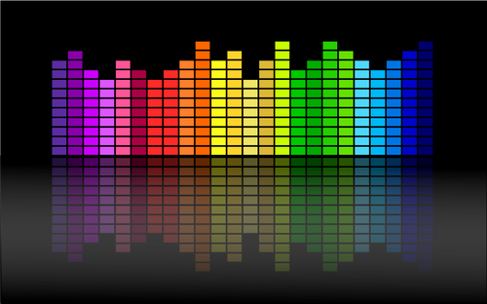
Project Summary
Graphic Analog Portable Equalizer
Problem Statement
The current market lacks equalizers that can be used in settings where complete wirelessness is needed.
Without both bluetooth input and output connectivity, a user is unable to control his/her speaker system settings on-the-go, and must instead have a dedicated location next to a speaker system from which to control a sound system.
Solution Proposal
The GrAPE is a graphic analog portable equalizer for the frequency range of 0-20 kHz with the ability to connect via Bluetooth or Auxiliary to any device/speaker with
these applications.
Notes:
Talk about what an equalizer is
Problem Statement about equalizers

Slide 3
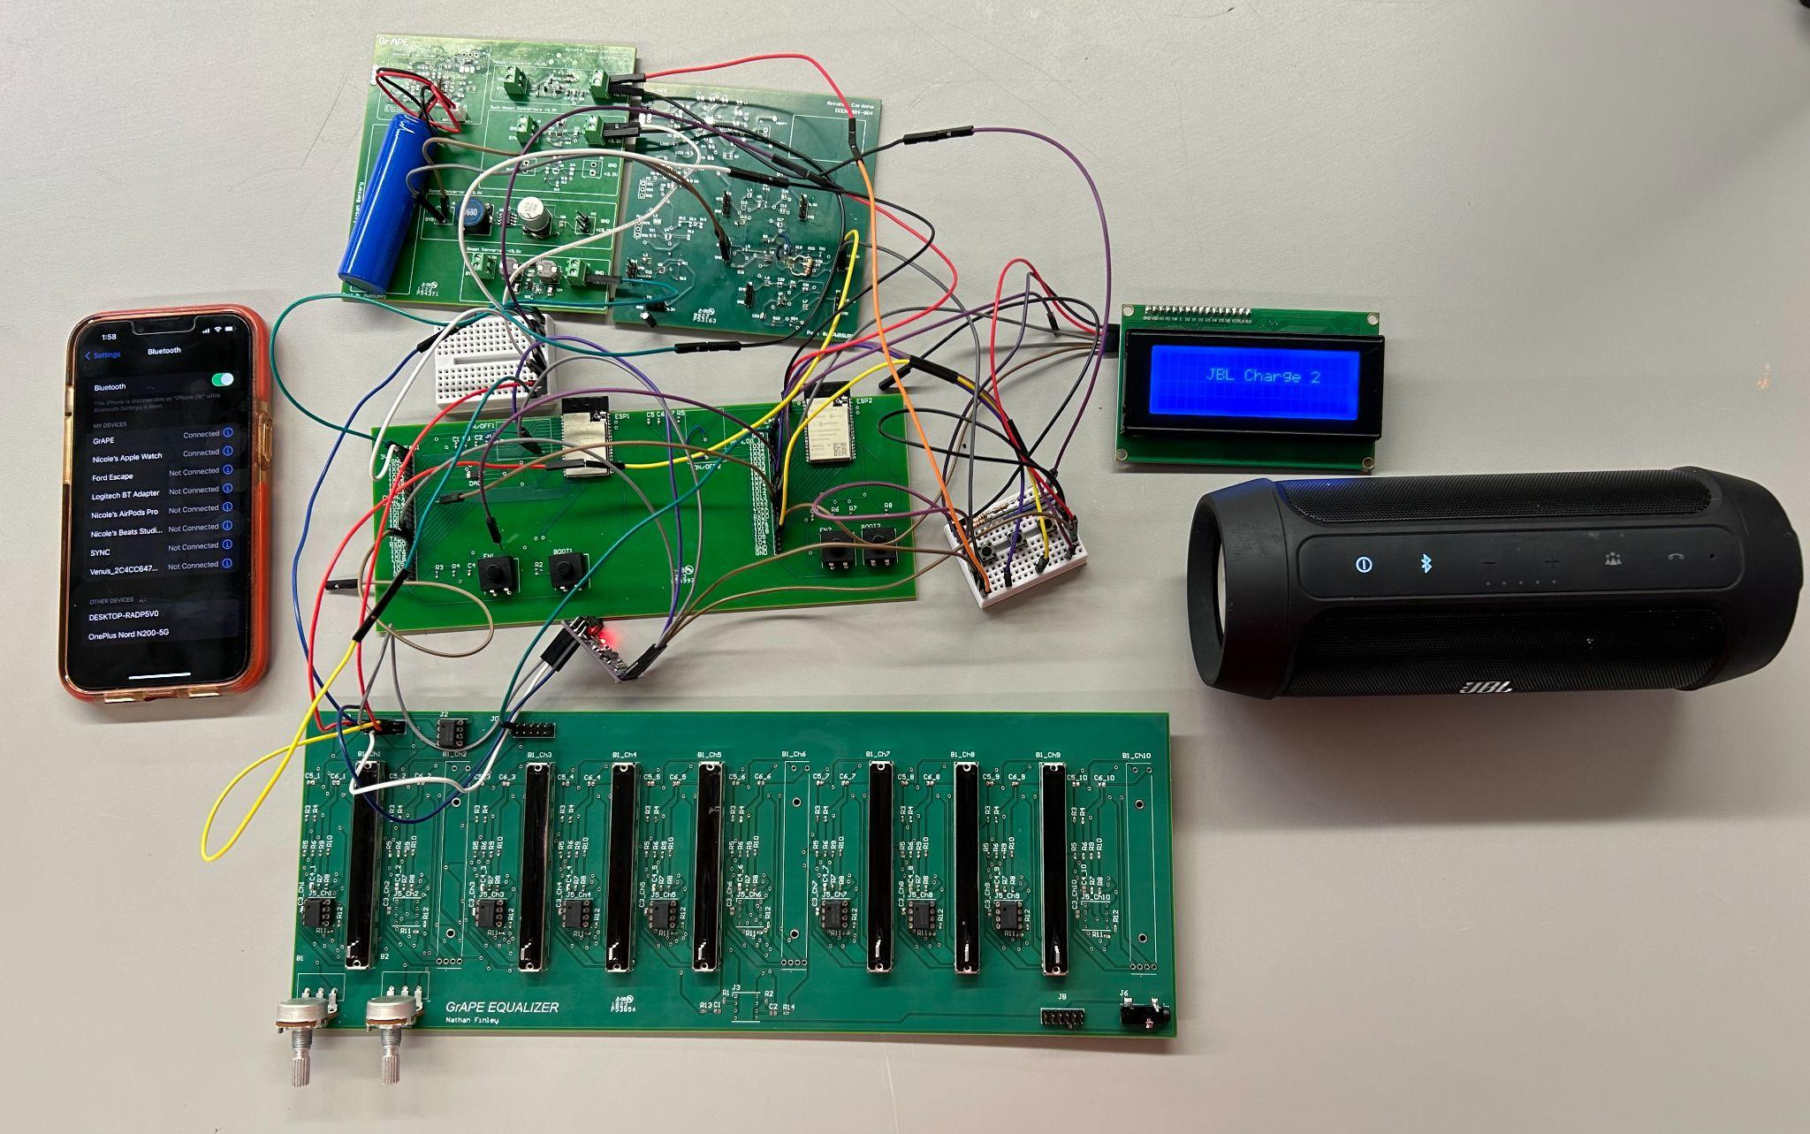
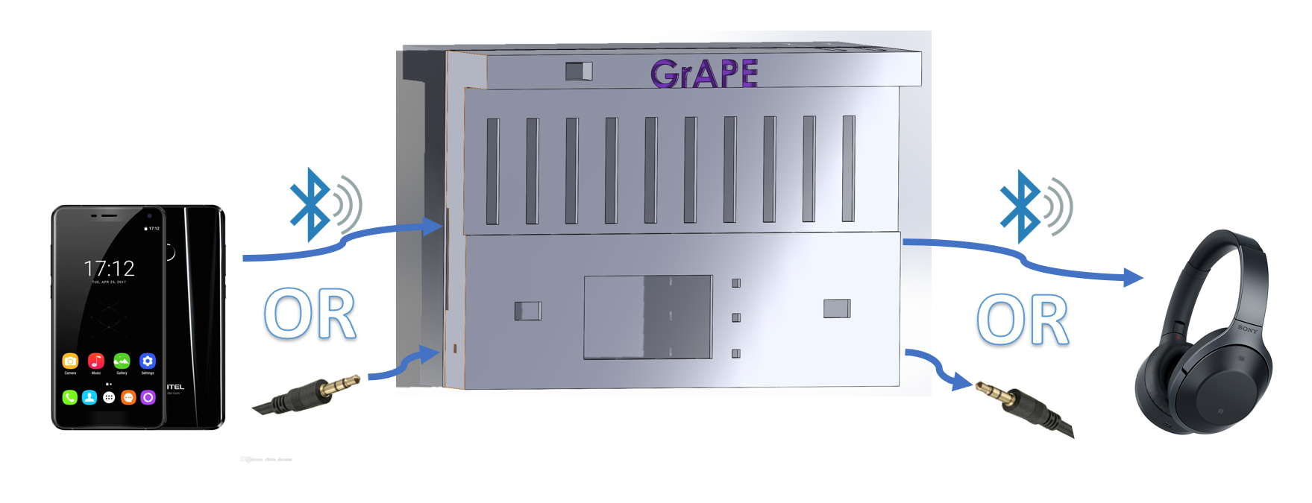
Integrated Project Diagram
Graphic Analog Portable Equalizer
Power Supply
Antonio Cardona
Nicole LoGiudice
Nathan Finley
Analog Input/Output
Bluetooth Input/Output
Bluetooth Input (Smartphone)
Bluetooth Receiver and Transmitter
LCD
AUX Input
Bluetooth Receiver (Speaker)
Equalizer
AUX Output

Slide 4
Engineering Design Accomplishments
Power Supply and User Interface
Graphic Analog Portable Equalizer
Challenges | Solutions
Output voltage of 3.3V Buck-Boost Converter was dropping to 0.0V when load current reached 800mA when the required load was 1A. Time consuming translation of LCD code from Arduino to Espressif Integrating issues between Bluetooth transmitter and the LCD code (double exception error) | Redesigned PCB, carefully placed and selected components following recommendation from the datasheet Performed research on the Espressif IDE and C programming language Extensive research and seek help from peers and professors

Slide 5
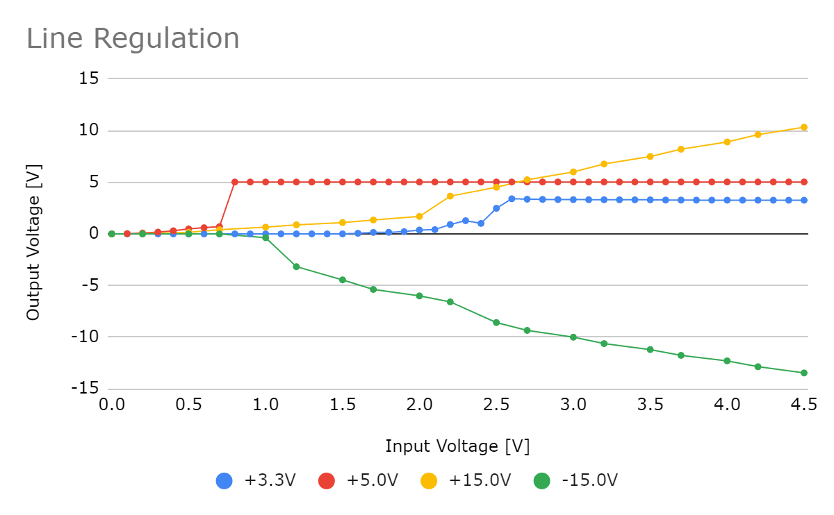
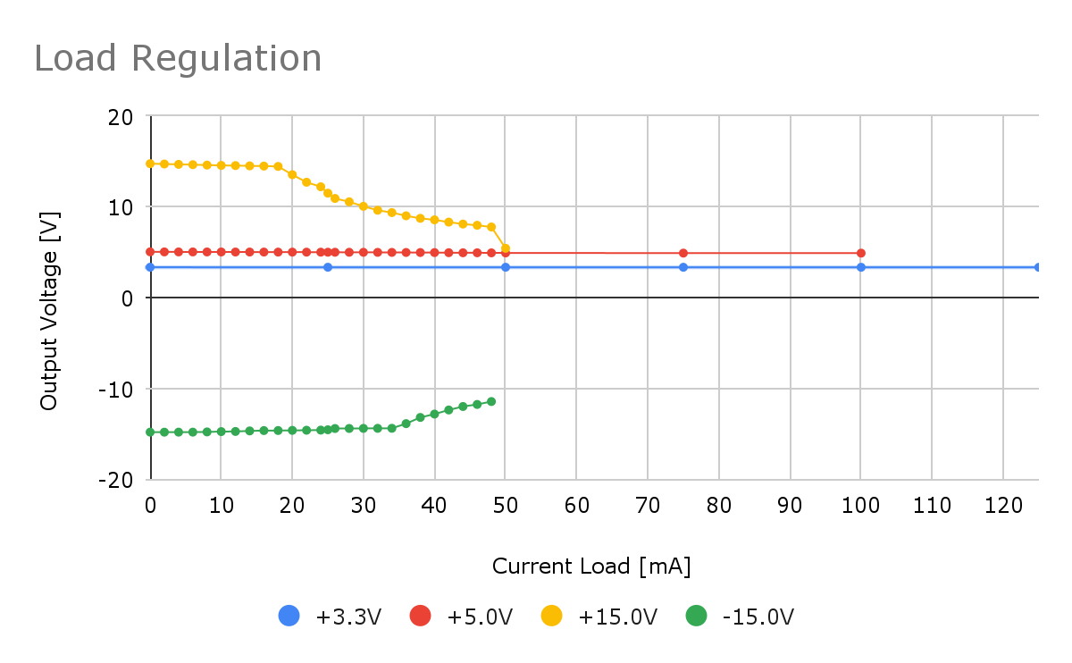
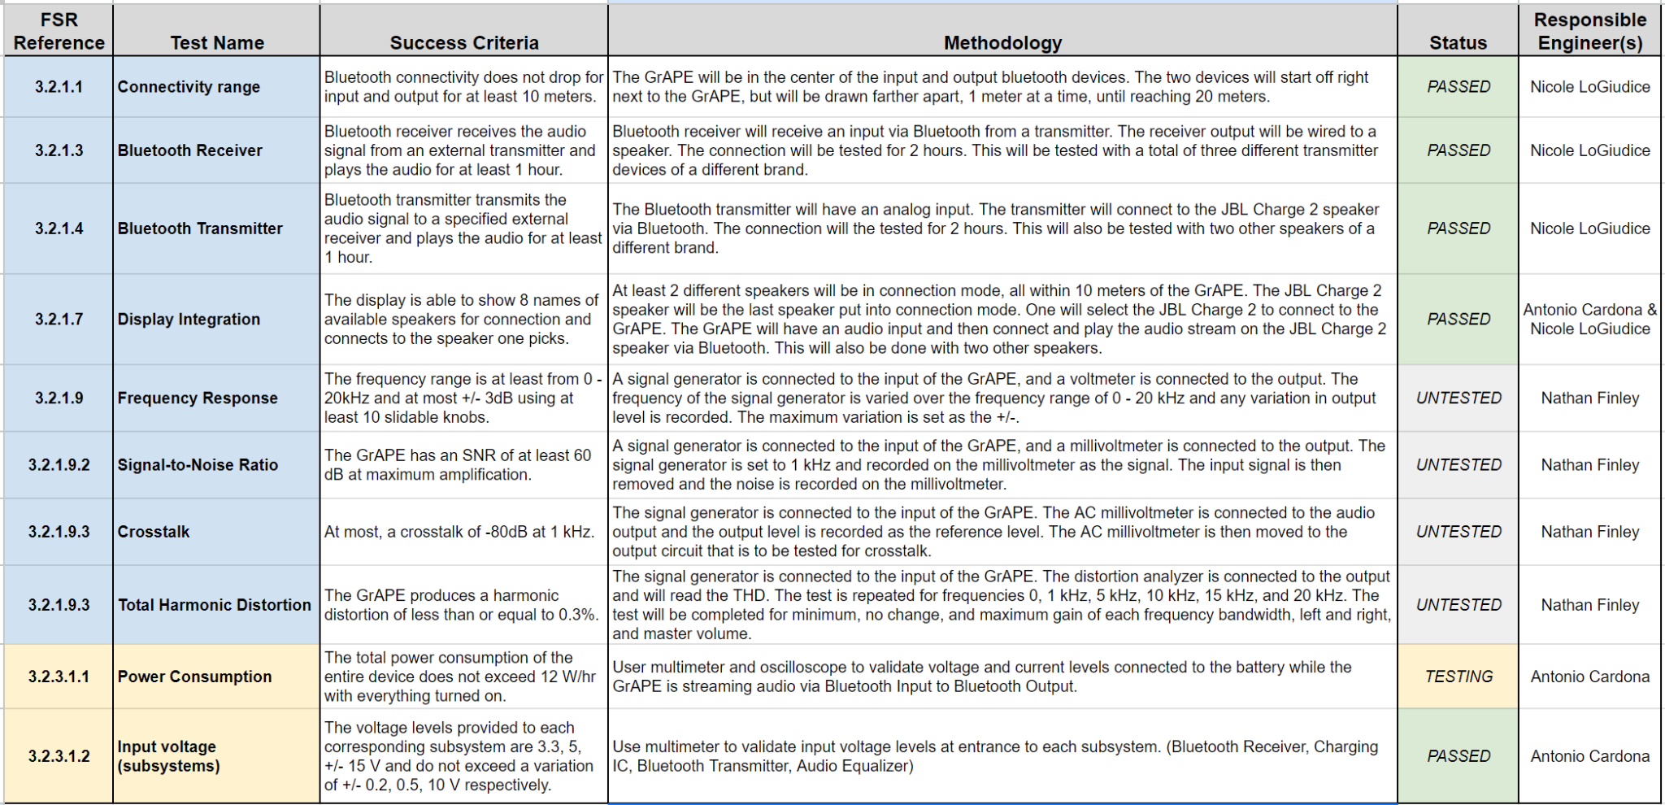
Engineering Design Accomplishments
Power Supply and User Interface
Graphic Analog Portable Equalizer

Slide 6
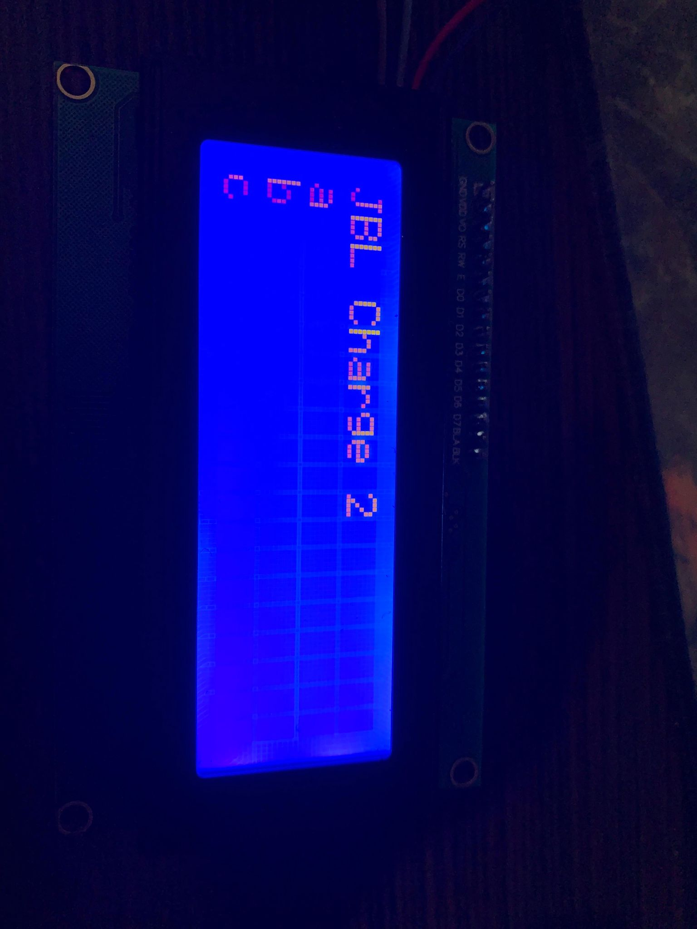
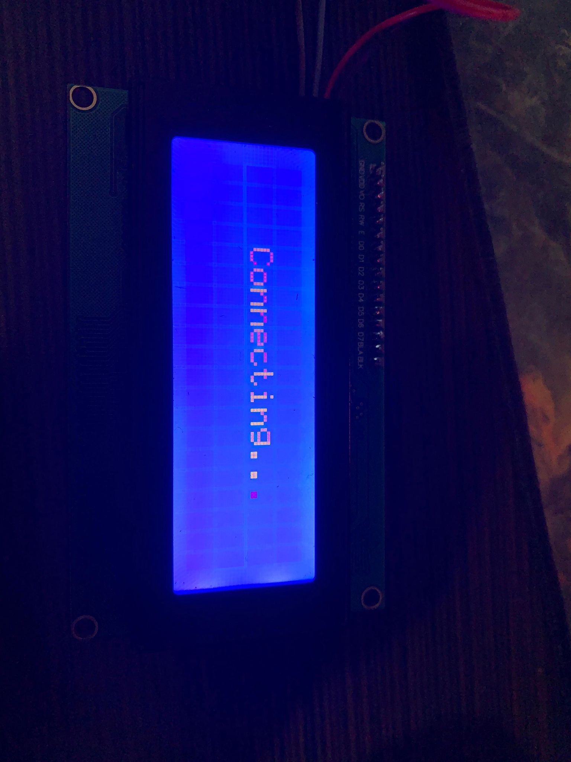
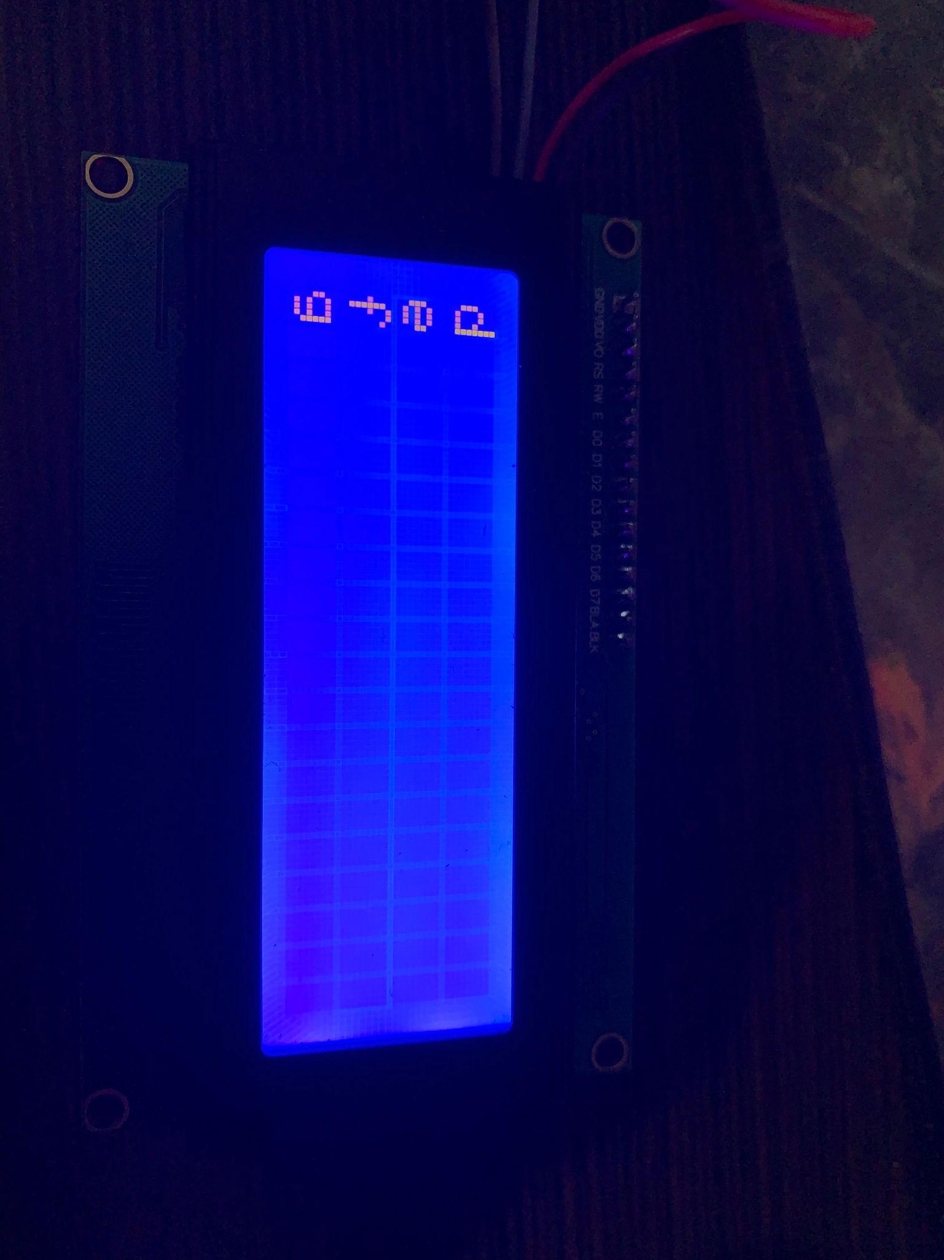
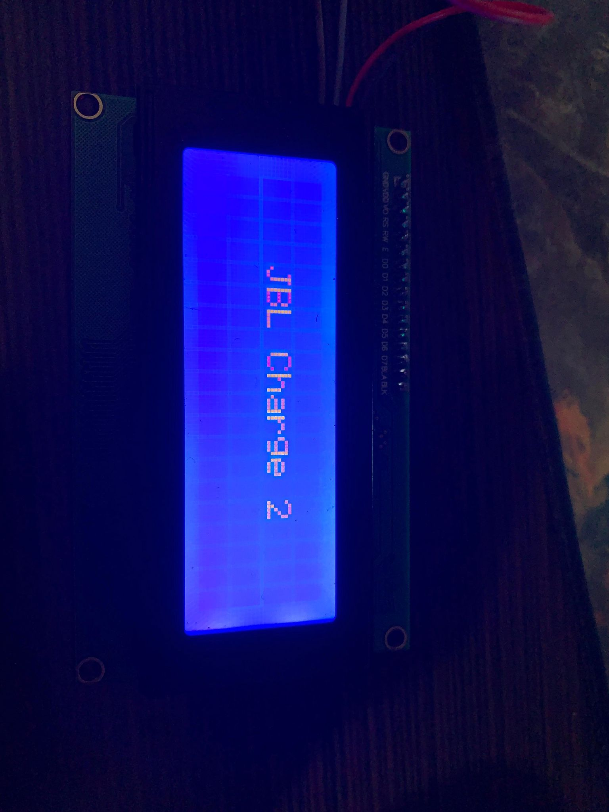
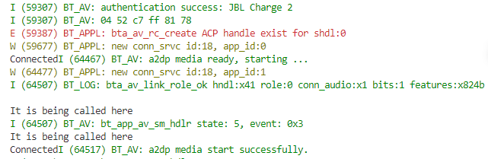
Engineering Design Accomplishments
Power Supply and User Interface
Graphic Analog Portable Equalizer

Slide 7
Engineering Design Accomplishments
Main Signal Processing
Graphic Analog Portable Equalizer
Challenges | Solutions
PCB’s input buffer stage (simple voltage follower) not reproducing input 500 Hz potentiometer causes no effect on output signal Protoboard design produces nearly no output | Input voltage was increased to a test-input of 4000 mVpp based on spec of NE5532AP op-amp Connected resistances and capacitances from other bands seemed to have been causing a low-resistance path for input signal; isolated 500Hz band Copper wire used was mostly non-conductive due to coating

Slide 8
Engineering Design Accomplishments
Main Signal Processing
Graphic Analog Portable Equalizer
Results: The equalizer can cut and boost 6 frequency ranges, each within 62.5 Hz - 4 kHz.
Band Center Frequency | Operational (Y/N) | Reasoning
31.25 Hz | N | No band soldered, capacitors required
62.5 Hz | Y | Boosts and cuts center frequency
125 Hz | Y | Boosts and cuts center frequency
250 Hz | Y | Boosts and cuts center frequency
500 Hz | N | No band soldered, capacitors required
1000 Hz | Y | Boosts and cuts center frequency
2000 Hz | Y | Boosts and cuts center frequency
4000 Hz | Y | Boosts and cuts center frequency
8000 Hz | N | No band soldered, capacitors required
16000 Hz | N | Band not operational on 16kHz

Slide 9
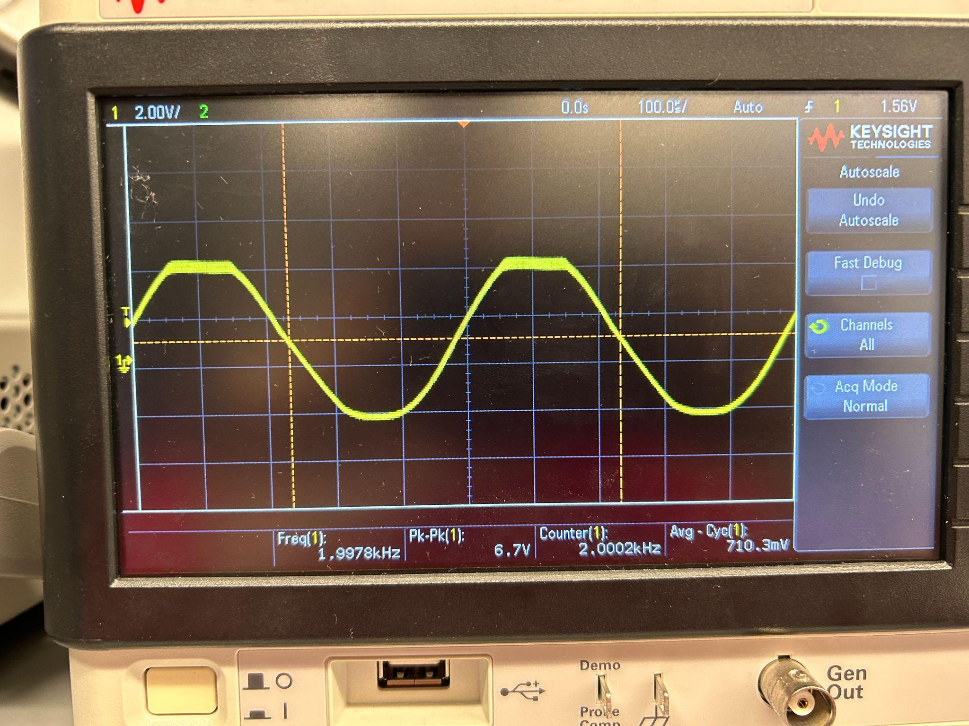
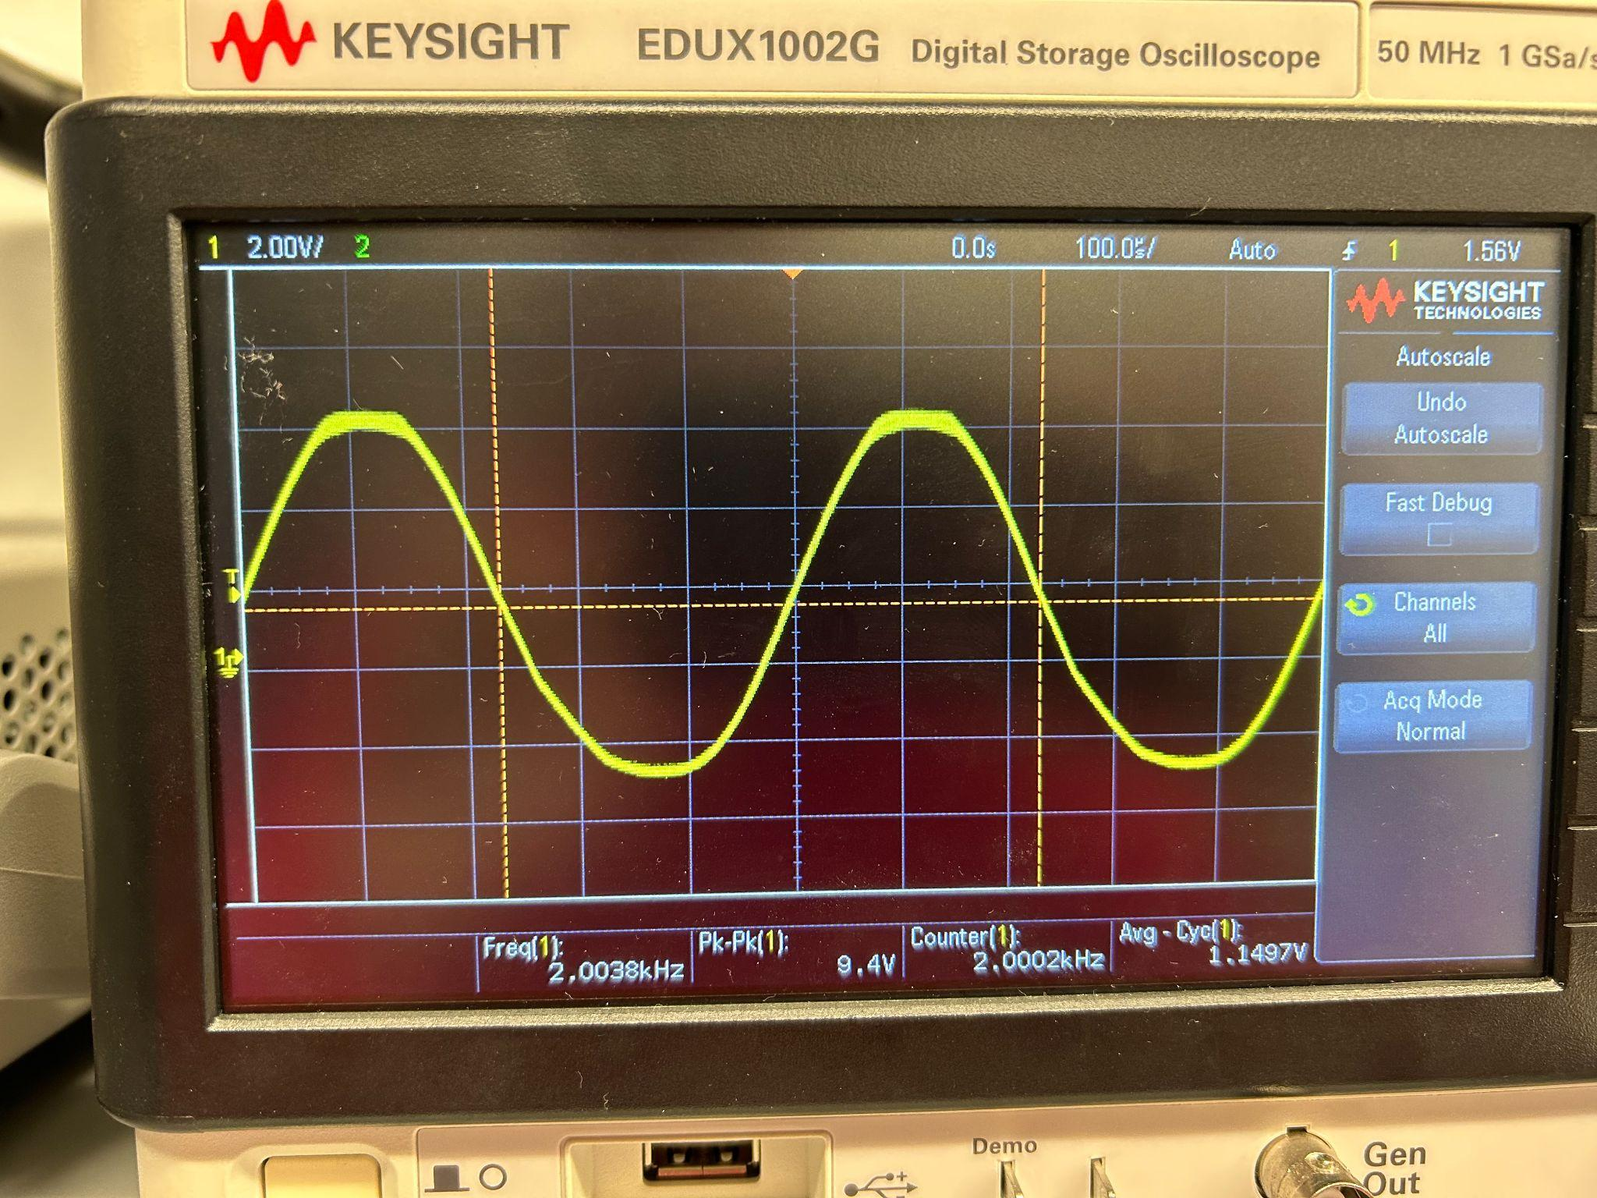
Engineering Design Accomplishments
Main Signal Processing
Graphic Analog Portable Equalizer
Characteristics of results using 2 kHz band:
tested cut and boost range is 6.7V Pk-Pk to 9.4V Pk-Pk. These conditions are optimized with input voltage as a variable.

Slide 10
Engineering Design Accomplishments
Bluetooth Connectivity
Graphic Analog Portable Equalizer
Challenges | Solutions
Utilizing I2S integration within code Finding the names of all the available speaker names PCB footprint larger than expected ESP32 flashing DAC not transmitting any signal | Implemented a buffer that would carry the signal within the chip Created a global pointer to contain all of the speaker names Redesigned footprint/printed out to scale altium design to check 10kOhms resistor to pull up Boot, 10kOhms resistors to pull down IO15 and IO2. Learning from past users. Utilized a DAC that has I2S integration and does not require programing.

Slide 11
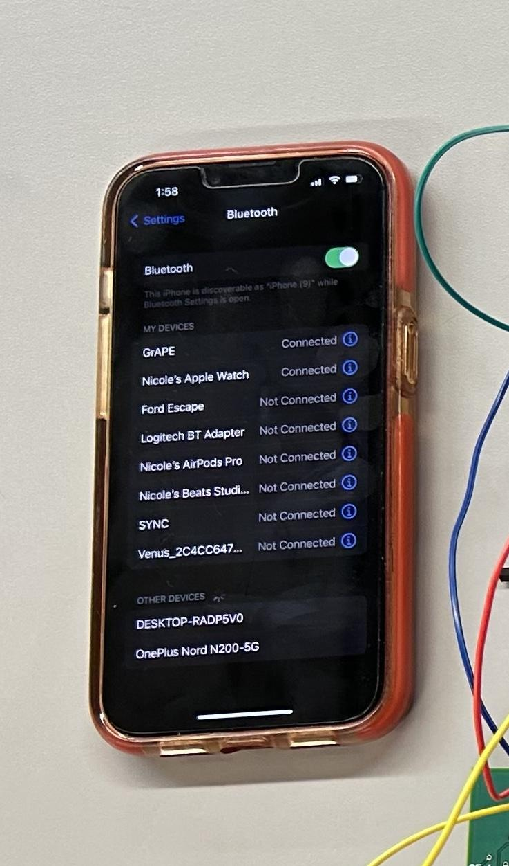
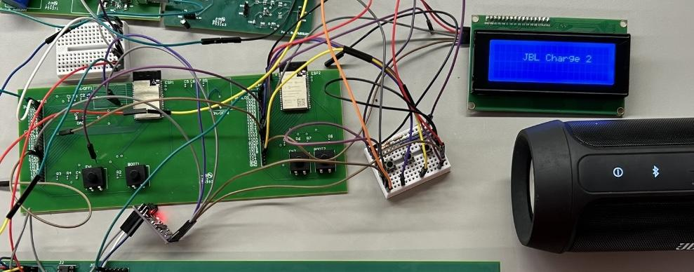
Engineering Design Accomplishments
Bluetooth Connectivity
Notes:
Picture of phone connection and JBL Charge 2 connected to the modules

Slide 12
Integrated System Results
Graphic Analog Portable Equalizer
Bluetooth Connectivity Range:
Did not drop connectivity for 20 meters from input or output connection.
Bluetooth Connectivity Longevity:
Did not drop connectivity from input or output connection for 2 hours.
Subsystem Input Voltage:
+5.0V Boost Converter handles expected 25mA load with a variation of +/- 0.2V
+3.3V Buck-Boost Converter handles expected 1.025A load with variation of +/- 0.5V
+15.0V Boost Converter handles expected 50mA load with variation of +/- 10V
-15.0V Boost Converter handles expected 50mA laid with variation of +/- 10V
LCD Functionality
Displays up to 20 receivers and user is able to sort through a maximum of 5 pages in the LCD menu
User is able to search, select, and connect to their desired bluetooth receiver through the LCD with UP, DOWN, and SELECT buttons
Equalizer functionality
Operational bands do not have a significant boost or cut effect on bands more than one neighbor away.
Notes:
Need something here about Nathan’s boost/cut ability

Slide 13
Conclusions
Graphic Analog Portable Equalizer
Issues
Bluetooth Transmitter Noise
16 kHz band does not create any response
Current Status
Edge Cases of LCD implementation
Implementing external ADC
Housing mounting integration
Finishing Bands of Equalizer

Slide 14

Thank you - Any Questions?
GrAPE

